Slide 1



Multimodal Deception Detection System
Ain Shams University
Faculty of Computers and Information Sciences
Team members :
Doaa Yehia
Medhat Essam
Mena Ashraf
Mohamed Moawad
Reem Ayman
Rodayna Mohamed
Department:
Computer Science
Supervisors:
Dr. Salsabil Amin
TA. Zeina Rayan

Slide 2

Agenda
Introduction
Problem Definition & Motivation
Objective
System Architecture
Phases description
Datasets
Experiments & Results
Demo
Challenges
Conclusion & future work
References

Slide 3

Introduction
Can you always spot a lie?
The ability of humans to detect deception is limited to around 54%.
Lies can have serious consequences in our personal and professional lives.

Slide 4
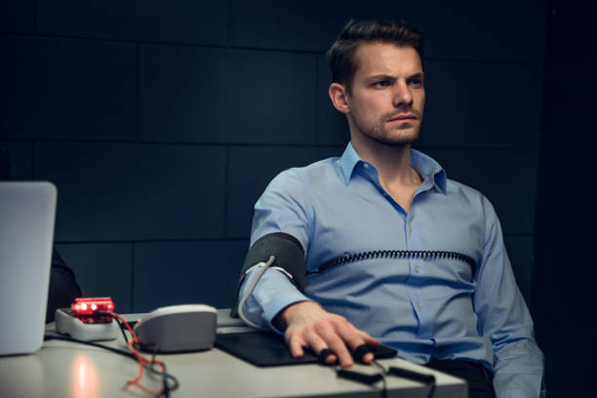
Problem Definition & Motivation
Traditional methods, like polygraph tests, are unreliable and invasive.
An accurate, non-invasive AI method for deception detection could significantly impact various fields.

Slide 5

Objective
Our goal in this project was to create a Multimodal deception detection web app that integrates information from multiple modalities such as verbal, nonverbal, physiological, and contextual cues to detect deception.

Slide 6
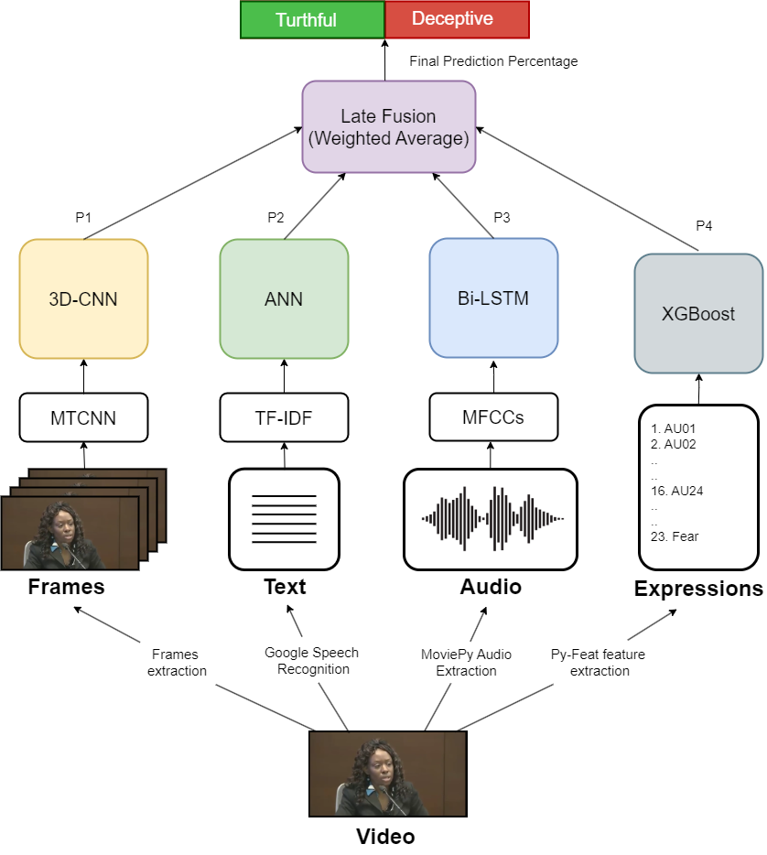
System Architecture
Model Architecture

Slide 7
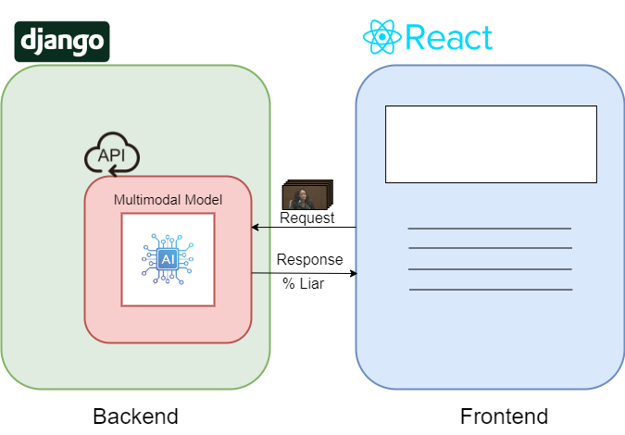
System Architecture (cont.)
Web App Architecture

Slide 8

Phases Description
Video Modality
Expressions Modality
Text Modality
Audio Modality
Multimodal
Web Application

Slide 9


1. Video Modality
When people lie, they exhibit involuntary expressions and movements.

Slide 10
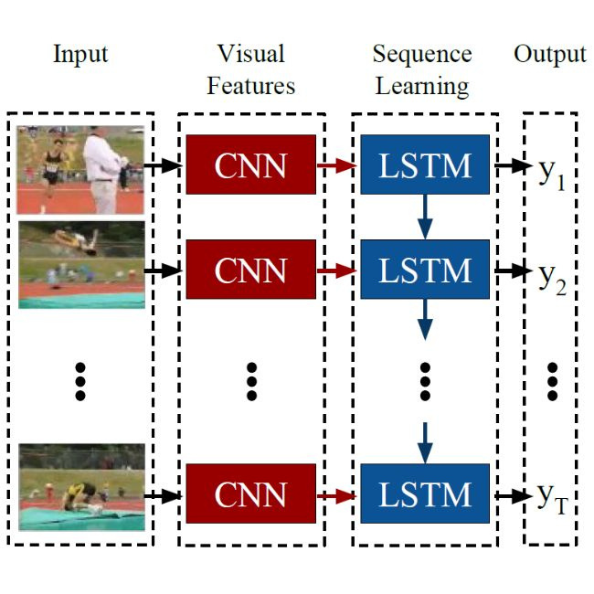
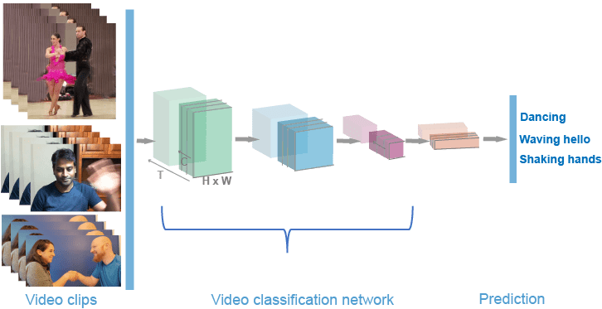
1. Video Modality
Various Neural Networks were used to identify deception through visual cues across video frames.

Slide 11
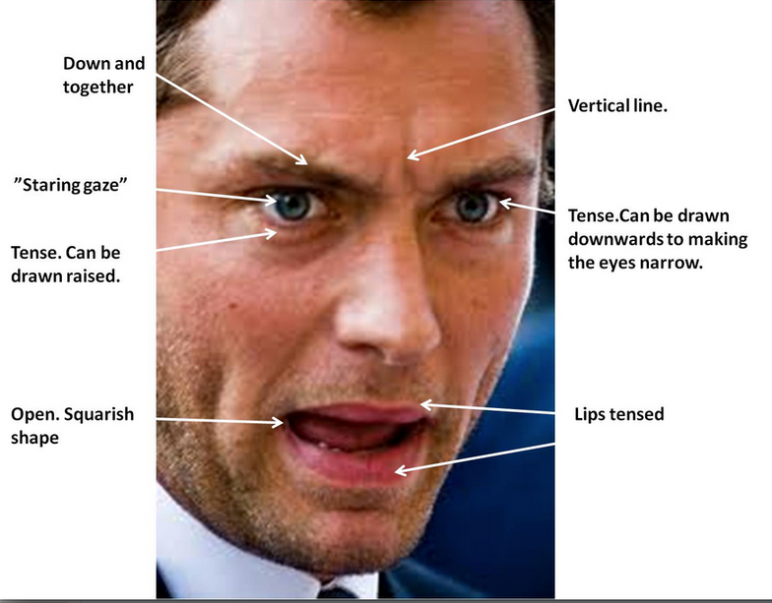
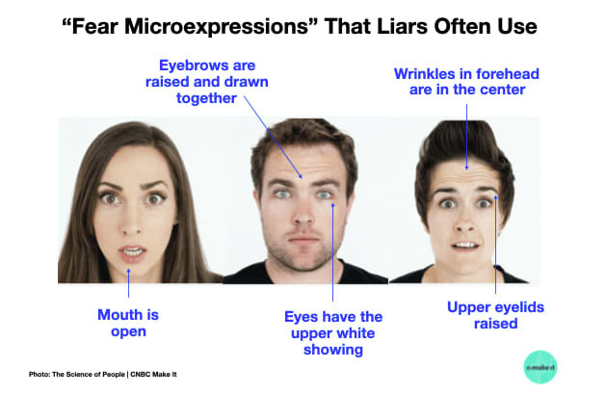
2. Expressions Modality
Micro expressions are brief, involuntary facial expressions that can reveal deception.

Slide 12
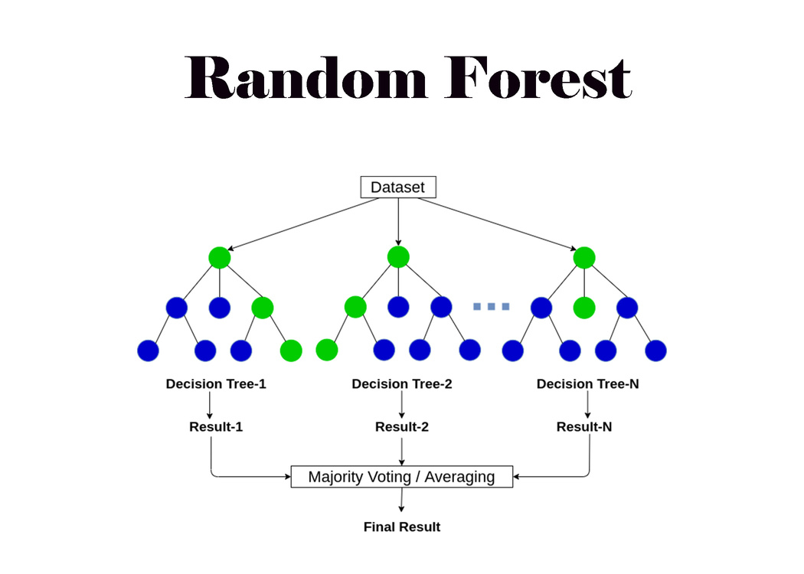
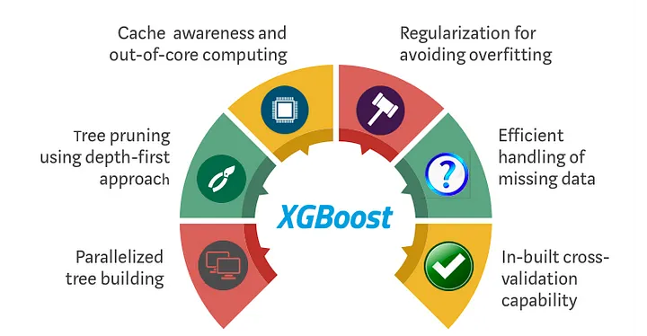
2. Expressions Modality
Machine learning classifiers such as XGBoost and Random Forests were employed to analyze these subtle cues to detect deception.

Slide 13


3. Text Modality
Linguistic cues such as word choice, syntax variation, and repetition can indicate deception in text.

Slide 14
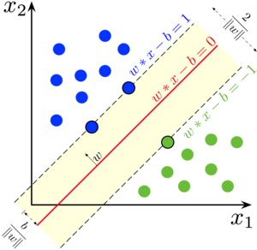

3. Text Modality
We used simple classifiers such as SVMs, and ANNs to detect deceptive patterns in natural language.

Slide 15


4. Audio Modality
Detecting deception through audio involves analyzing vocal cues like pitch, tone, pauses and hesitations.

Slide 16
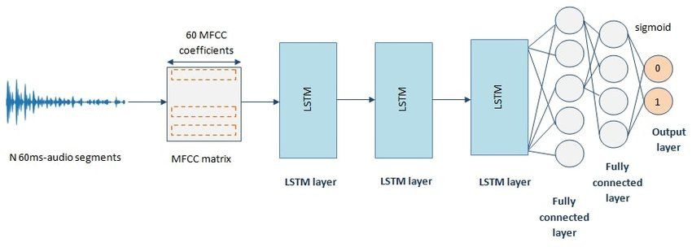
4. Audio Modality
RNNs excel in recognizing patterns and inconsistencies indicative of deception in audio signals.

Slide 17
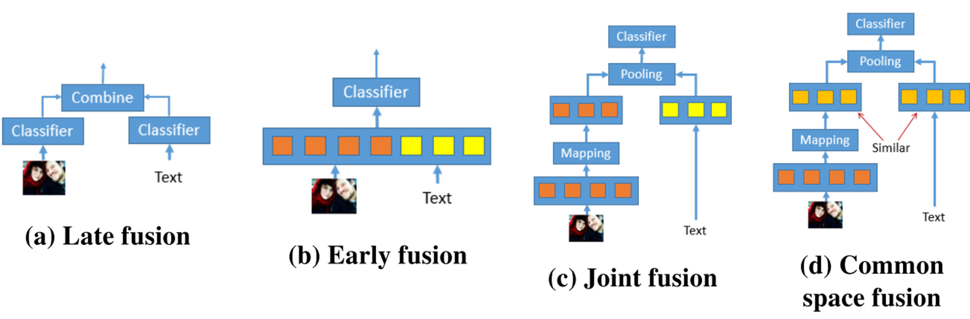
5. Multimodal
Integrating data from multiple sources such as audio, video, and text can create a richer data representation for deception detection.

Slide 18


6. Web Application
The backend is powered by Django, offering a simple API for model integration. The frontend uses React for a straightforward and intuitive user interface.

Slide 19

Description of Datasets

Slide 20
Description of datasets
Real-life Deception Detection Dataset:
The dataset was released in 2015.
It comprises a collection of 121 real-life courtroom trial videos of which 60 are truthful and 61 are deceptive.
The dataset is accompanied by annotations of various gestures and behaviors observed within the videos.

Slide 21
Description of datasets (cont.)
Miami University Deception Detection Database
The dataset was released in 2017.
It contains 320 videos of 80 individuals spanning different racial backgrounds and genders.
This database is accompanied by an excel codebook which includes data related to the videos and subjects in the database.

Slide 22
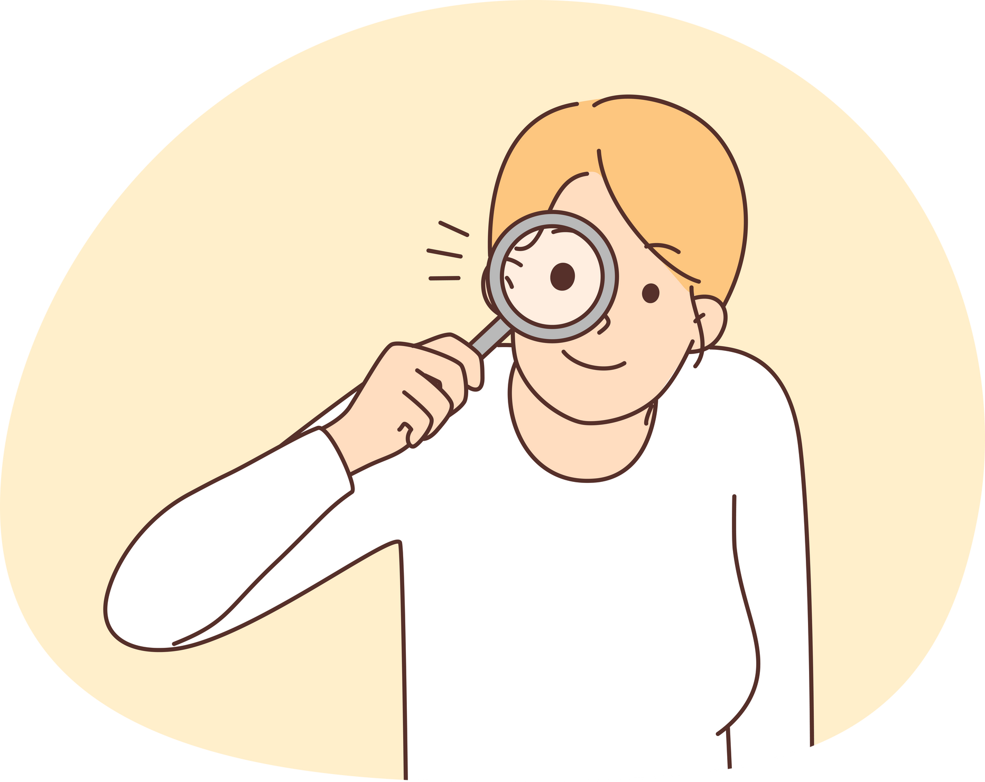
Dataset Choice
Experiments on the Miami University Dataset showed poor results of around 50-55% Accuracy, with a slight improvement in text modality at 70% but overall, it was insufficient for multimodal experimentation.
This is likely due to its data collection method which relied on planned surveys unlike Real-life Dataset which employs natural deception.
Due to these findings, we decided to shift our focus to the Real-life Dataset which is backed by more credible research.

Slide 23

Experiments & Results

Slide 24
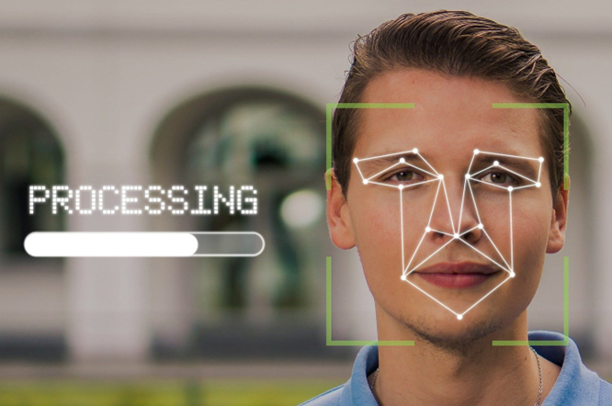
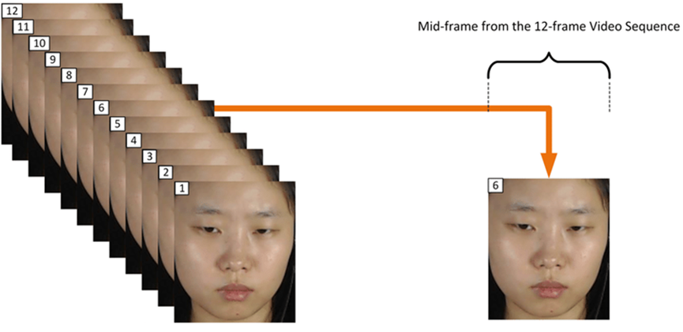
Video Modality Experiments
Video frames are normalized to be of the same sequence length and resolution using OpenCV, and subject faces are cropped.

Slide 25

Video Modality Results
Model Name | Face Detector | Sample Shape | Test Accuracy
3D CNN | Haar Cascade Frontal Face | 100x64x64x1 | 83.3%
CNN-LSTM | Haar Cascade Frontal Face | 100x64x64x1 | 70.8%
3D CNN | MTCNN | 100x64x64x1 | 87.5%
CNN-LSTM | MTCNN | 100x64x64x1 | 79.1%

Slide 26
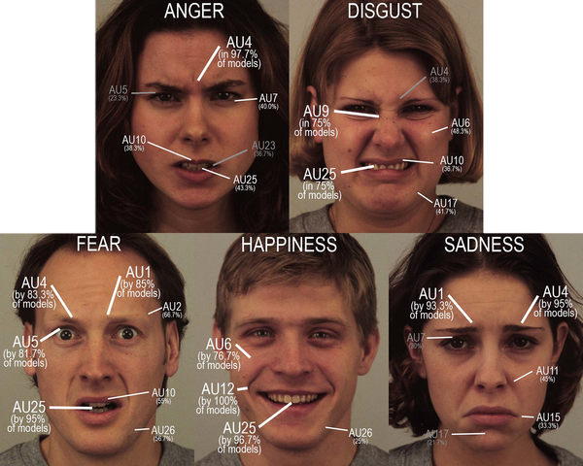
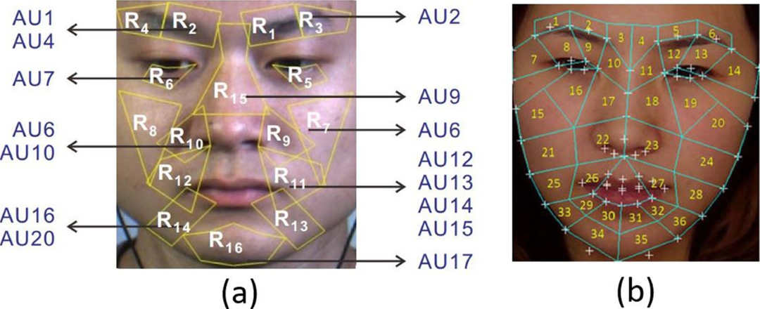
Expressions Modality Experiments
Action units (AUs) and emotions such as anger and fear were extracted using Py-Feat to model micro expressions.

Slide 27
Expressions Modality Results
Model Name | Best Parameters | Test Accuracy
SVM | kernel = ‘poly’, degree = 2, C = 1, coef0 = 0.5, gamma = ‘auto' | 54.1%
Decision Tree | criterion = ‘gini’, Splitter = ‘best’, Max_depth = None | 62.5%
Random Forest | n_estimators = 1500, max_leaf_nodes = 10, max_depth=50 | 66.7%
XGBoost | max_depth = 6, n_estimators = 100, booster = ‘gbtree’ | 75%

Slide 28
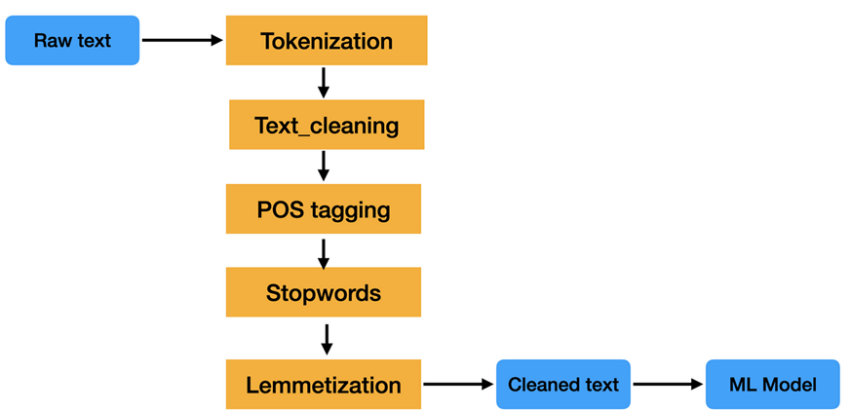
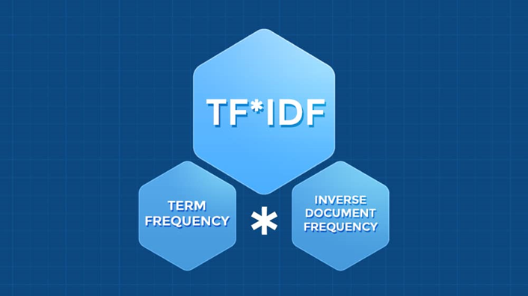
Text Modality Experiments
Transcripts were cleaned using an NLP pipeline and then vectorized using TF-IDF or Glove.

Slide 29
Text Modality Results
Model Name | Vectorizer | Parameters | Test Accuracy
SGD | TF-IDF | Alpha = 0.0001, learning_rate = 'optimal' | 70.8%
SVM | TF-IDF | kernel = 'linear', C = 10 | 75%
ANN | TF-IDF | learning_rate = 0.01 | 79.1%
ANN | Glove 100d | learning_rate = 0.01 | 70.8%

Slide 30
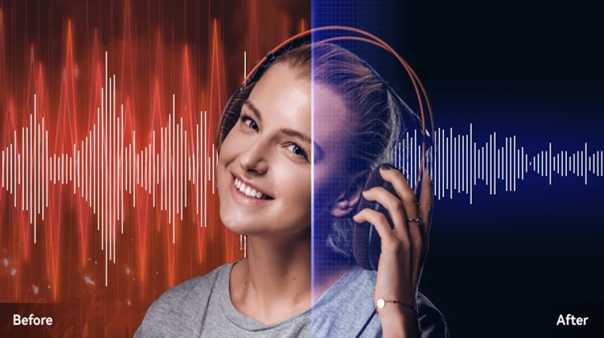
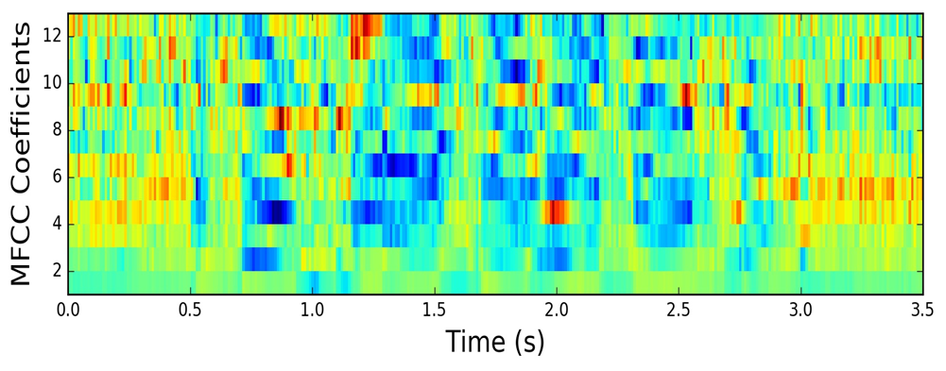
Audio Modality Experiments
STFT was applied to the audio signals to reduce noise artifacts, then MFCCs were extracted using Librosa.

Slide 31
Audio Modality Results
Model Name | Number of MFCCs samples | Test Accuracy
LSTM | 700 | 70.8%
GRU | 700 | 70.8%
Bi-LSTM | 700 | 79.1%
Bi-LSTM | 2000 | 75%

Slide 32
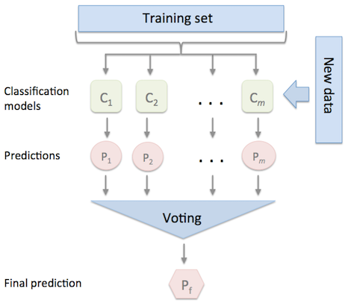
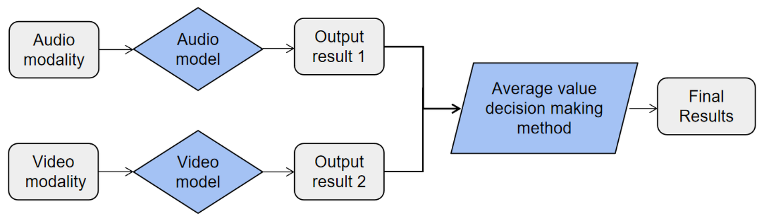
Multimodal Experiments
Predictions from single modalities were combined using late fusion techniques such as weighted average and majority voting.

Slide 33
Multimodal Results
Model Name | Fusion Type | Test Accuracy
A+V+T | Majority Voting | 95.8%
A+V+T | Weighted Average W = [0.15, 0.5, 0.35] | 91.6%
A+V+T+E | Majority Voting | 91.6%
A+V+T+E | Weighted Average W = [0.25, 0.25, 0.25, 0.25] | 87.5%

Slide 34
Competitive Analysis
Citation | Dataset | Methodolgy | Best Accuracy
Ahmed, Hammad Ud Din, et al. (2021) | Real Life Deception Detection Dataset | FACS with LSTM | 89.4%
Mathur, Leena, and Maja J. Matarić (2020) | Real Life Deception Detection Dataset | Visual and vocal features with AdaBoost | 84%
Krishnamurthy, Gangeshwar, et al (2018) | Real Life Deception Detection Dataset | Early fusion with visual, vocal and linguistic features | 96.1%
Proposed method | Real Life Deception Detection Dataset | Late fusion with visual, vocal and linguistic features | 95.8%

Slide 35

Demo

Slide 36
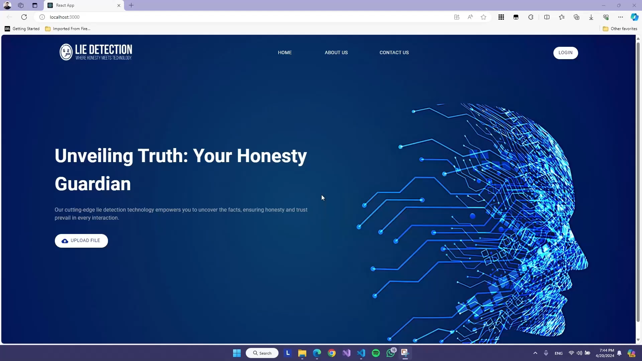

Slide 37
Challenges
Challenge: In Real-Life Deception Detection Dataset, same subjects often reappear in multiple videos with consistent behavior, risking bias. Disproportionate gender representation in deceptive videos adds to potential bias with random dataset splits.
Solution: Manually create training and testing sets with new unseen subjects in the test set and ensure equal gender distribution to mitigate bias.

Slide 38
Challenges (cont.)
Challenge: Varied video quality, with some videos featuring multiple subjects, and others being unusable due to poor visibility or inadequate audio quality In Real-Life Deception Detection Dataset.
Solution: Edit videos to isolate individual subjects and remove completely unusable footage to ensure data quality.

Slide 39
Conclusion
Our AI-driven application leverages advanced machine learning algorithms to analyze behavioral and linguistic cues, providing a highly accurate method for detecting deception.
Unlike traditional methods, it requires no specialized hardware, making it more accessible, cost-effective, and a scalable method for detecting deception.

Slide 40
Future Work
Expanding the training dataset with more diverse videos to improve generalizability.
Experimenting with other multimodal fusion techniques such as Early Fusion.
Developing real-time analysis capabilities.

Slide 41
References
Perez-Rosas, V., Abouelenien, M., Mihalcea, R., Burzo, M.: Deception detection using real-life trial data. In: Proceedings of the 2015 ACM on International Conference on Multimodal Interaction, ACM (2015).
Şen, M.U., Perez-Rosas, V., Yanikoglu, B., Abouelenien, M., Burzo, M. and Mihalcea, R., 2020. Multimodal deception detection using real-life trial data. IEEE Transactions on Affective Computing, 13(1), pp.306-319.
Bareeda, E.F., Mohan, B.S. and Muneer, K.A., 2021, May. Lie detection using speech processing techniques. In Journal of Physics: Conference Series (Vol. 1921, No. 1, p. 012028). IOP Publishing.
Ahmed, H.U.D., Bajwa, U.I., Zhang, F. and Anwar, M.W., 2021. Deception detection in videos using the facial action coding system. arXiv preprint arXiv:2105.13659.
Mathur, L. and Matarić, M.J., 2020, October. Introducing representations of facial affect in automated multimodal deception detec-tion. In Proceedings of the 2020 International Conference on Multimodal Interaction (pp. 305-314).

Slide 42
References (cont.)
Rill-García, R., Jair Escalante, H., Villasenor-Pineda, L. and Reyes-Meza, V., 2019. High-level features for multimodal deception detection in videos. In Proceedings of the IEEE/CVF Conference on Computer Vision and Pattern Recognition Workshops (pp. 0-0).
S. Feng, R. Banerjee, and Y. Choi. Syntactic stylometry for deception detection. In Proceedings of the 50th Annual Meeting of the Association for Computational Linguistics: Short Papers - Volume 2, ACL ’12, pages 171–175, Stroudsburg, PA, USA, 2012. Association for Computational Linguistics.
Barathi, C.S., 2016. Lie detection based on facial micro expression body language and speech analysis. International Journal of Engineering Research & Technology, 5(2), pp.337- 343.
T. Yang, G.-M. Liu, and S. C.-H. . Huang, “Multimodal Deception Detection in Videos via Analyzing Emotional State-based Feature,” arXiv:2104.08373 [cs], Apr. 2021.
H. Karimi, J. Tang, and Y. Li, “Toward End-to-End Deception Detection in Videos,” IEEE Xplore, Dec. 01, 2018.

Slide 43

Thank you very much!

